Slide 1
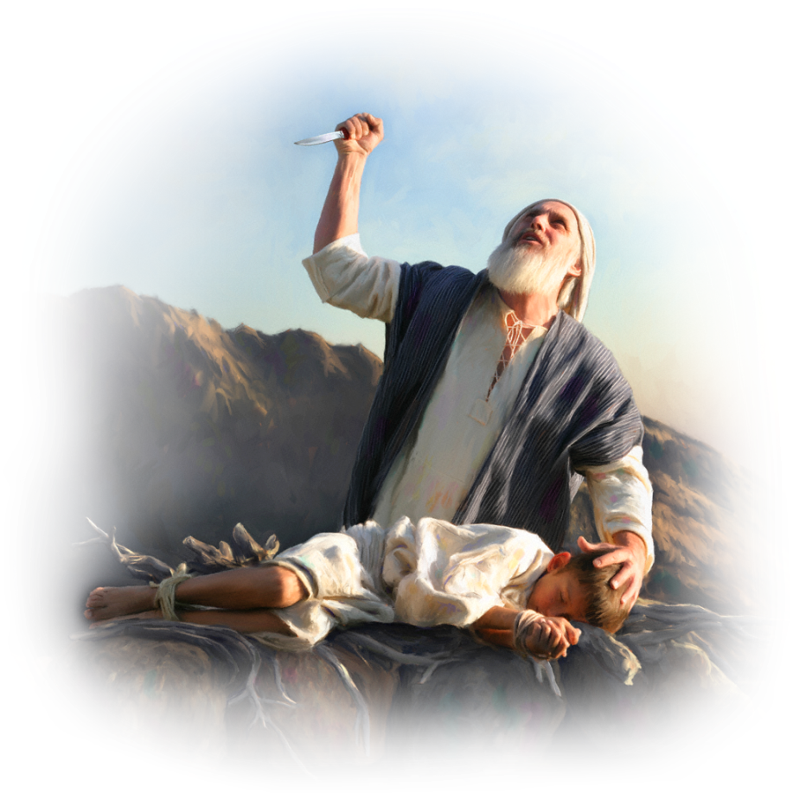
“Yahweh-Jireh”
“EL SEÑOR PROVEERÁ”
The LORD Will Provide
Pr. Azael D. Pittí

Slide 2
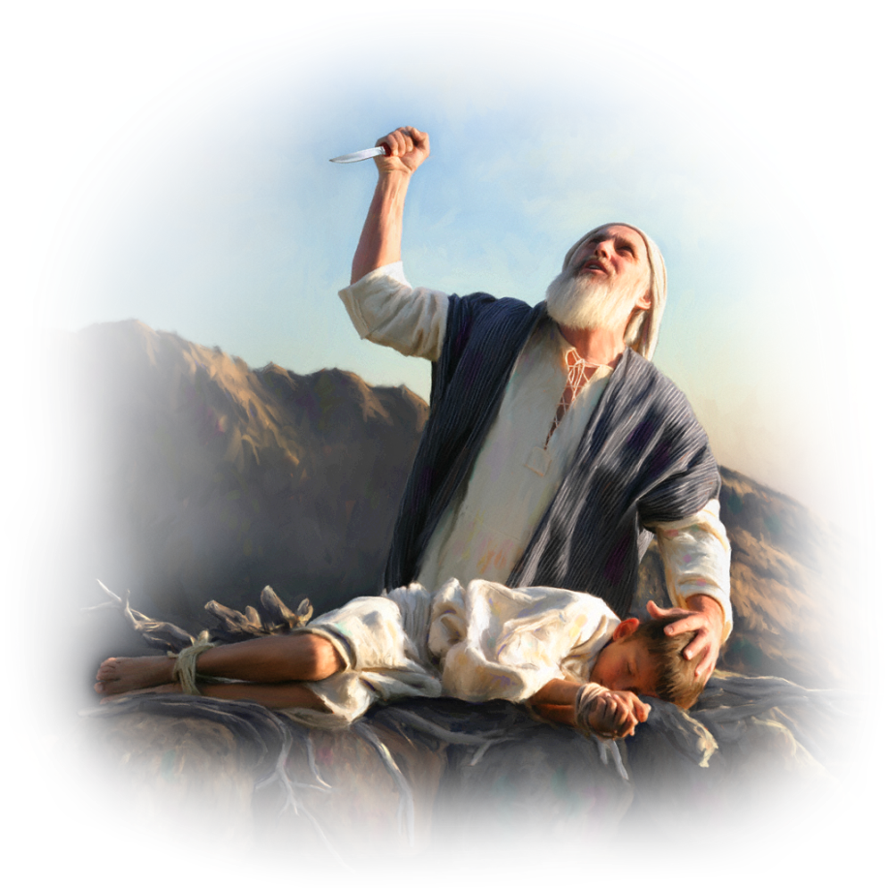
Genesis 22:1-14
Some time later God tested Abraham. He said to him, "Abraham!" "Here I am,"
he replied.

Slide 3
Genesis 22:1-14
² Then God said, "Take your son, your only son, Isaac, whom you love, and go to the region of Moriah. Sacrifice him there as a burnt offering on one of the mountains I will tell
you about."

Slide 4
Genesis 22:1-14
³ Early the next morning
Abraham got up and s
addled his donkey. He took
with him two of his servants and his son Isaac. When he had cut enough wood for the burnt offering, he set out for the place God had told him about.

Slide 5
Genesis 22:1-14
⁴ On the third day
Abraham looked up and
saw the place in
the distance.

Slide 6
Genesis 22:1-14
⁵ He said to his servants, "Stay here with the donkey while I and the boy go over there. We will worship and then we will come back to you."

Slide 7
Genesis 22:1-14
⁶ Abraham took the wood for the burnt offering and placed it on his son Isaac, and he himself carried the fire and the knife.
As the two of them
went on together,

Slide 8
Genesis 22:1-14
⁷ Isaac spoke up and said to his father Abraham, "Father?" "Yes, my son?" Abraham replied. "The fire and wood are here,"
Isaac said, "but where is
the lamb for the
burnt offering?"

Slide 9
Genesis 22:1-14
⁸ Abraham answered,
"God himself will provide
the lamb for the burnt offering, my son." And the two of them went on together.

Slide 10
Genesis 22:1-14
⁹ When they reached the place God had told him about, Abraham built an altar there and arranged the wood on it. He bound
his son Isaac and laid
him on the altar, on top
of the wood.

Slide 11
Genesis 22:1-14
¹⁰ Then he reached out
his hand and took the knife to slay his son.

Slide 12
Genesis 22:1-14
¹¹ But the angel of the LORD called out to him from heaven, "Abraham! Abraham!" "Here I am," he replied.

Slide 13
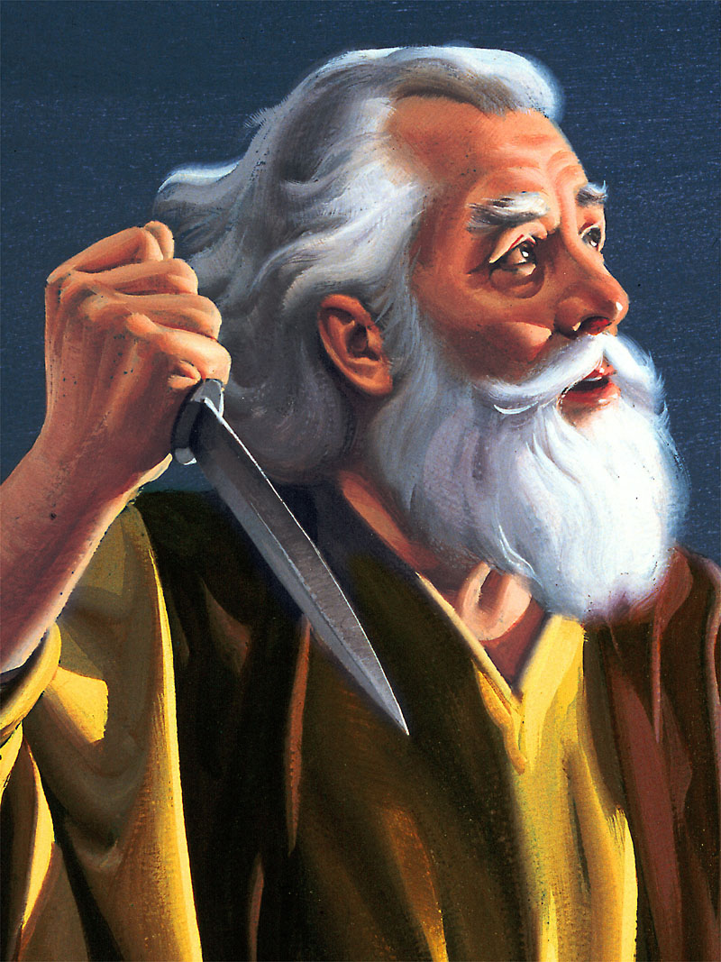

Slide 14
Genesis 22:1-14
¹² "Do not lay a hand on the boy," he said. "Do not do anything to him. Now I know that you fear God, because you have not withheld from me
your son, your
only son."

Slide 15
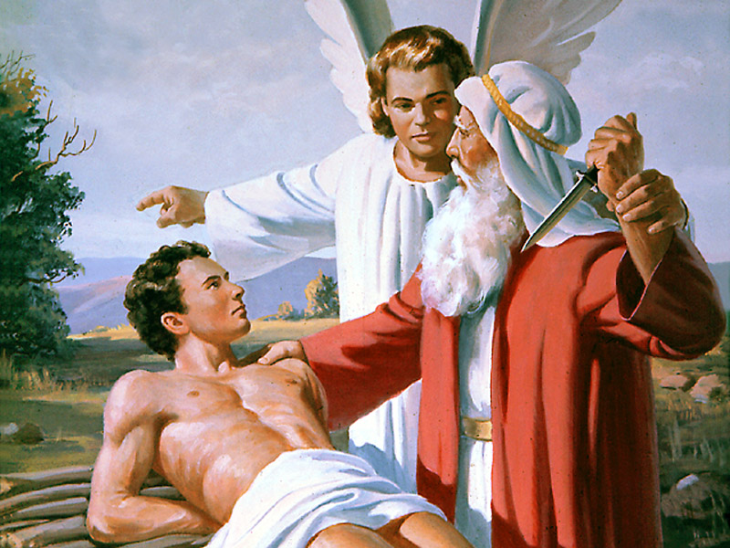

Slide 16
Genesis 22:1-14
¹³ Abraham looked
up and there in a thicket
he saw a ram caught by its
horns. He went over and took the ram and sacrificed it as a burnt offering instead of his son.

Slide 17
Genesis 22:1-14
¹⁴ So Abraham called that place The LORD Will Provide. And to this day it is said, "On the mountain of the LORD
it will be provided."

Slide 18
Hebreos 11:17-19
“Por la fe Abraham, cuando fue probado, ofreció a Isaac: el que había recibido las promesas, ofrecía su unigénito,

Slide 19
Hebreos 11:17-19
¹⁸ habiéndosele dicho: "En Isaac te será llamada descendencia",

Slide 20
Hebreos 11:17-19
¹⁹ porque pensaba que Dios es poderoso para levantar aun de entre los muertos, de donde, en sentido figurado, también lo volvió a recibir.

Slide 21
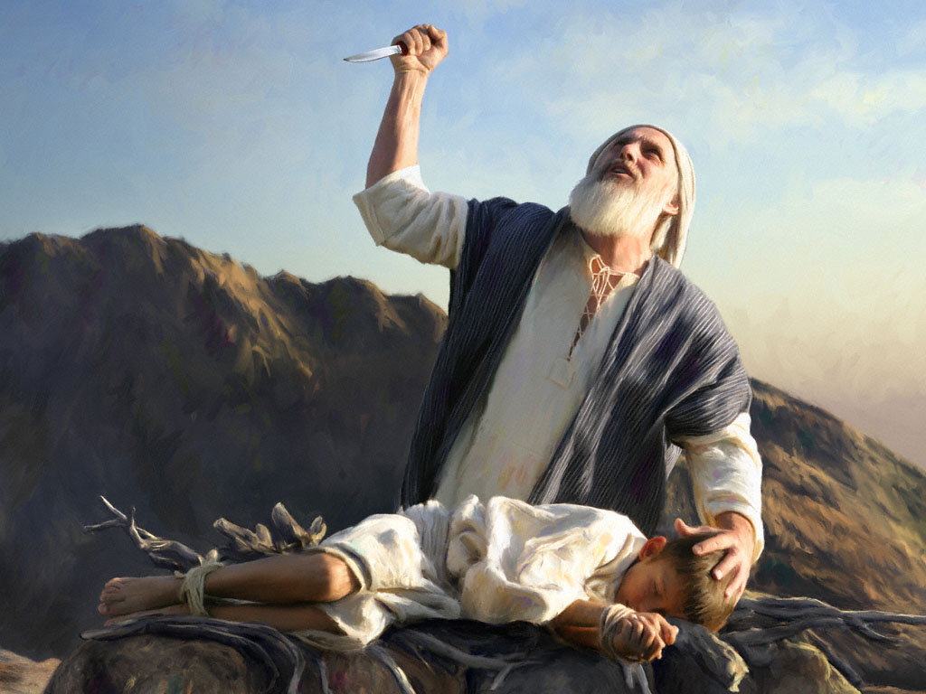

Slide 22
“Yahweh-Jireh”
“EL SEÑOR PROVEERÁ”
The LORD Will Provide
Pr. Azael D. Pittí

